Slide 1
Cyber-security Considerations
Team 16
Paul Earhart, Haoran Geng, Dustin Kline, Larry Kozlowski
Supervisor: Dr. Padgett
Client: Rolls-Royce

Slide 2
Overview
Project Description
System Overview
Analogous Car System
Hacking Device
Demo System
Current Progress
Technical Risks
Questions?

Slide 3

Project Description
Vehicles are becoming more electronic
More systems are being controlled by machines
There is little to no security in vehicles
Tasked with
Creating an emulated car system
Penetration testing of a car system
Hardening a car system against attacks

Slide 4
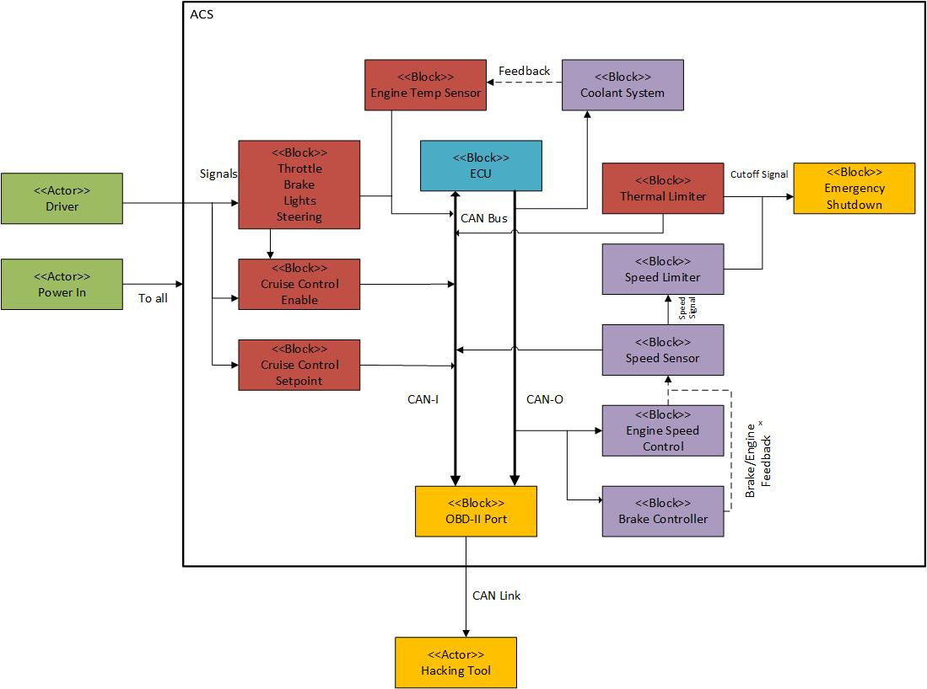
Analogous Car System
Emulated Vehicle
Comprised of
Engine Control Unit - BeagleBone Black
Critical System Nodes - Arduino Nanos
Interface - CAN bus

Slide 5
Analogous Car System
Safety Critical Systems
Engine Controller
Brake Controller
Speed Controller
Cooling System Controller

Slide 6
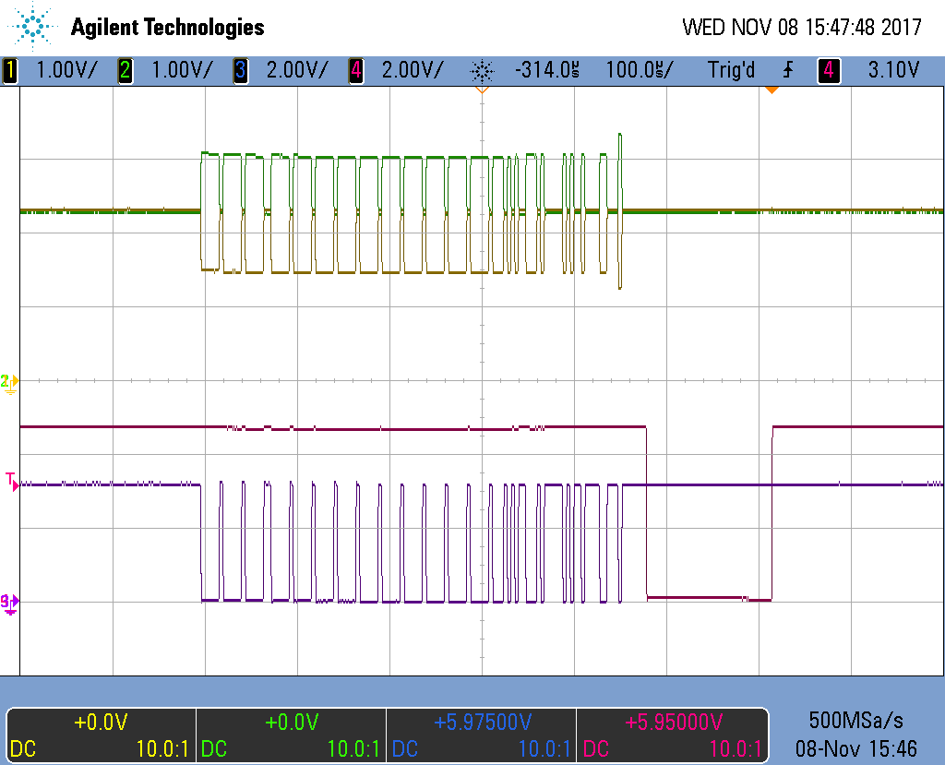
Analogous Car System
Multi-node CAN bus
Controller Area Network
2-wire bus
NO security
CAN Bus Data Frames

Slide 7
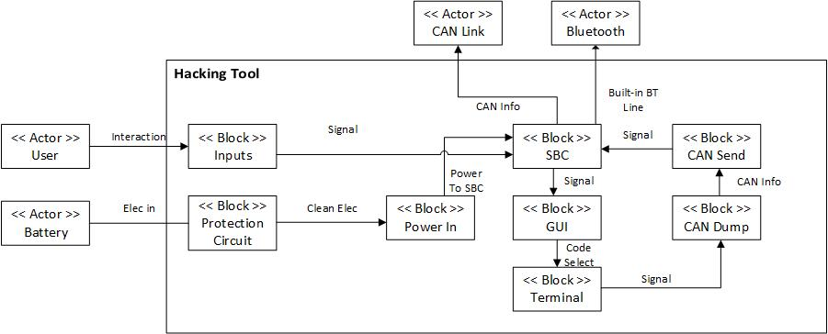
Hacking Device
Portable AIO Package
Battery Powered
OBD-II Compatible
Easy GUI to begin attacks

Slide 8

Hacking Device
Multiple Attacks
Destructive Denial of Service (DDoS)
Flood the bus so nodes can’t communicate
Effectively shutting down a system
Man in the Middle
Pretend we are a trusted node
Send information to destroy or debilitate sub systems

Slide 9
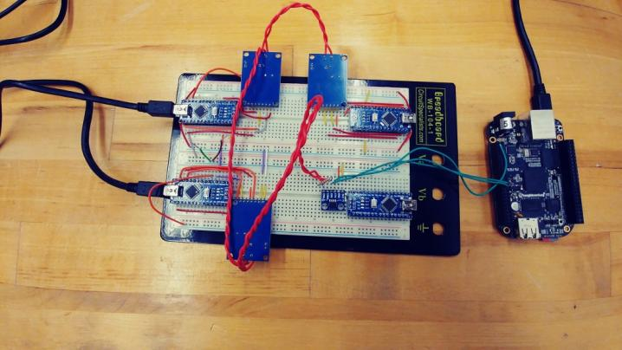
Progress
Analogous Car System - 90%
Completed - Nodes Created, CAN Bus working
TODO - Add sensors to nodes instead of emulating outputs
Hacking Device - 10%
Completed - Connected to CAN bus
TODO - Write software package, Make portable
Hardened Car System - 0%
TODO - Find ways to stop/prevent attacks
Current Analogous Car System

Slide 10

Risks
Hacking Device
Attacks working reliably
Making it portable enough
Hardened Car System
Finding ways to prevent attacks

Slide 11
Questions?

